Slide 1

JPA and Hibernate in 10 Steps
1

Slide 3
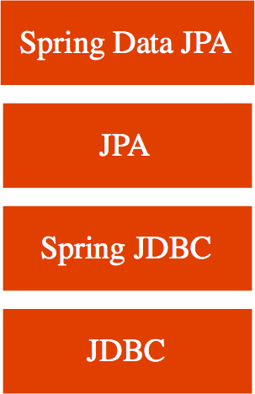
Getting Started with JPA and Hibernate
Build a Simple JPA App using Modern Spring Boot Approach
Get Hands-on with JPA, Hibernate and Spring Boot
World before JPA - JDBC, Spring JDBC
Why JPA? Why Hibernate? (JPA vs Hibernate) Why Spring Boot and Spring Boot Data JPA? JPA Terminology: Entity and Mapping

Slide 4
Learning JPA and Hibernate - Approach
01: Create a Spring Boot Project with H2 02: Create COURSE table
03: Use Spring JDBC to play with COURSE table
04: Use JPA and Hibernate to play with COURSE table
05: Use Spring Data JPA to play with COURSE table

Slide 5
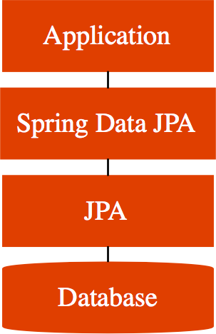
Spring Boot Auto Configuration Magic
We added Data JPA and H2 dependencies:
Spring Boot Auto Configuration does some magic:
Initialize JPA and Spring Data JPA frameworks
Launch an in memory database (H2)
Setup connection from App to in-memory database
Launch a few scripts at startup (example: data.sql, schema.sql)
Remember - H2 is in memory database
Does NOT persist data
Great for learning
BUT NOT so great for production

Slide 6
JDBC to Spring JDBC to JPA to Spring Data JPA
JDBC
Write a lot of SQL queries! (delete from todo where id=?)
And write a lot of Java code
Spring JDBC
Write a lot of SQL queries (delete from todo where id=?)
BUT lesser Java code
JPA
Do NOT worry about queries
Just Map Entities to Tables!
Spring Data JPA
Let's make JPA even more simple!
I will take care of everything!

Slide 7
JDBC to Spring JDBC
JDBC example
public void deleteTodo(int id) { PreparedStatement st = null; try {
st = db.conn.prepareStatement("delete st.setInt(1, id);
st.execute();
} catch (SQLException e) {
from
todo
where
id=?");
logger.fatal("Query Failed
} finally {
if (st != null) {
try {st.close();}
: ", e);
catch (SQLException e) {}
}
}
}
Spring JDBC example
public void deleteTodo(int id) { jdbcTemplate.update("delete from todo where
}
id=?", id);

Slide 8
JPA Example
@Repository
public class PersonJpaRepository {
@PersistenceContext EntityManager entityManager;
public Person findById(int id) {
return entityManager.find(Person.class,
}
id);
public Person update(Person person) { return entityManager.merge(person);
}
public Person insert(Person person) { return entityManager.merge(person);
}
public void deleteById(int id) {........
Spring Data JPA Example
public interface TodoRepository extends JpaRepository<Todo, Integer>{

Slide 9
Hibernate vs JPA
JPA defines the specification. It is an API.
How do you define entities?
How do you map attributes? Who manages the entities?
Hibernate is one of the popular implementations of JPA
Using Hibernate directly would result in a lock in to Hibernate
There are other JPA implementations (Toplink, for example)

